Slide 1
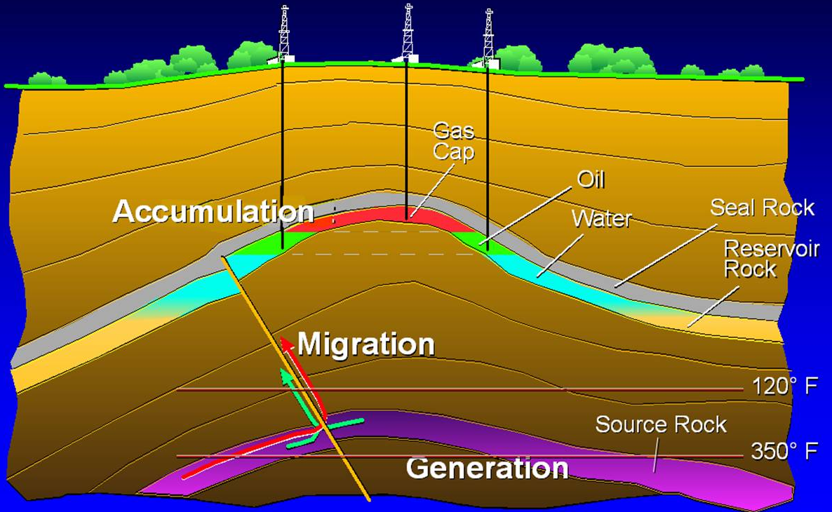
Petroleum system
50°C
175°C
Necessary elements:
Source rock
Reservoir rock
Seal rock
Overburden
Necessary processes:
Trap formation
Generation of hydrocarbons (by maturation)
Hydrocarbon migration and accumulation in trap

Slide 2
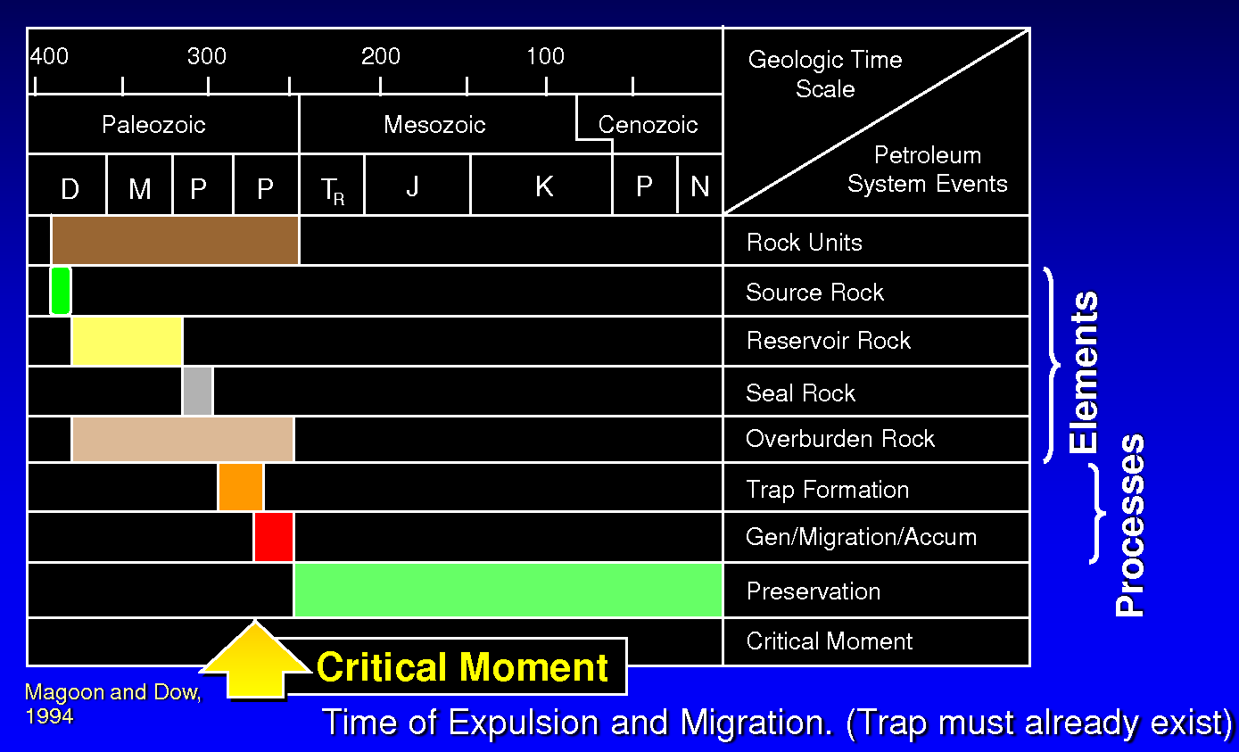
Petroleum system

Slide 3
Petroleum systems exercise
Overleaf shows a geological cross section through the south Pyrenean foreland basin in Spain (modified after Robert 2018), the geological column in a well drilled in the center, and the subsidence curve for that well. This data set allows an assessment of the petroleum system in the basin. The aim of the exercise is to complete the systems chart overleaf.
Tasks:
1. Using the stratigraphic column, identify the petroleum systems elements (source, reservoir, seal, overburden). There may be more than one of each.
2. Determine from the cross section the most likely traps, where they are, their type (stratigraphic vs structural), and when they formed – the latter information should go in the systems chart.
3. Draw the subsidence chart for the well, establish the thermal history of the well, and determine timings for oil/gas generation (see last week’s exercise).
4. When was (were) the critical moment(s)?
5. Do you expect oil and/or gas in any reservoirs?

Slide 4
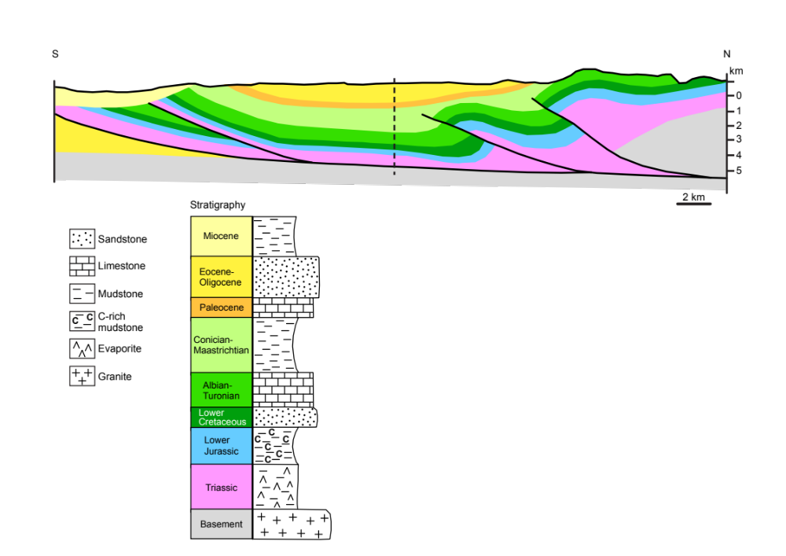
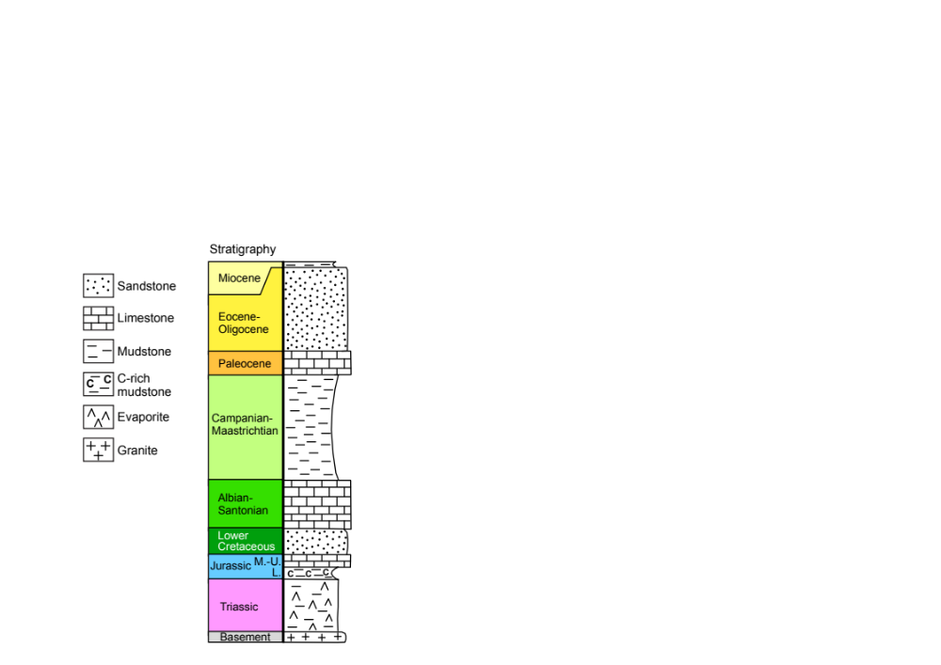
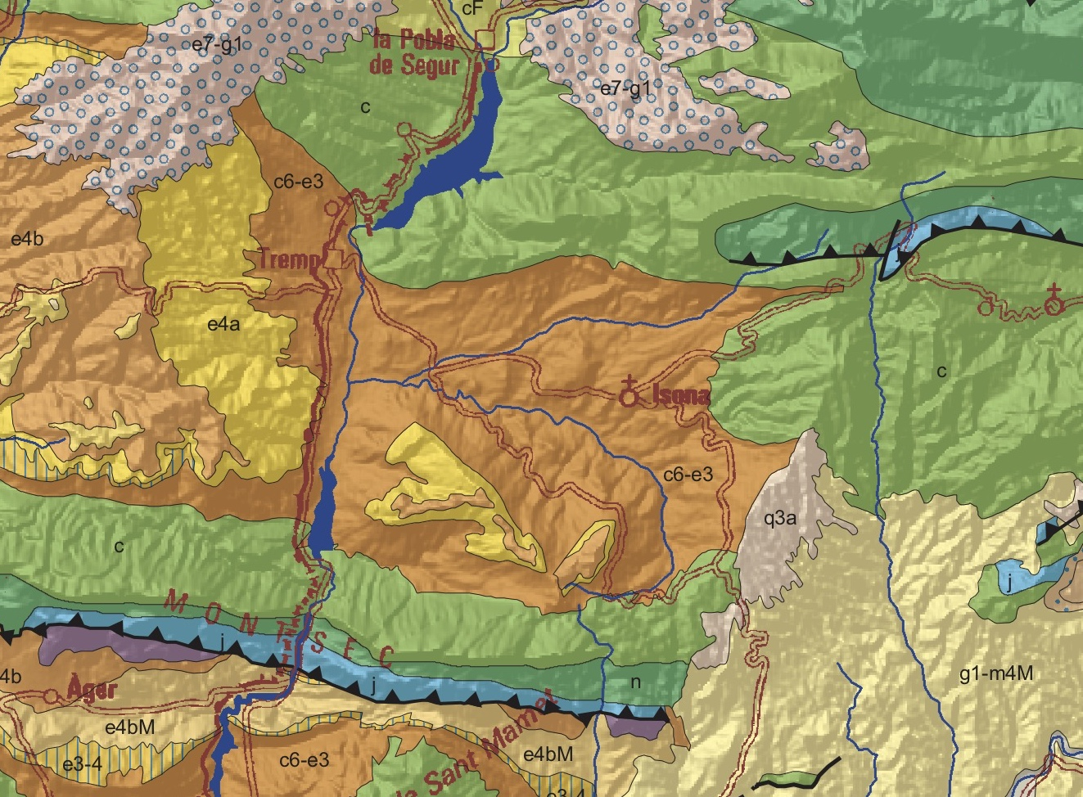
well
Geological map (colors not identical)
© IGC

Slide 5
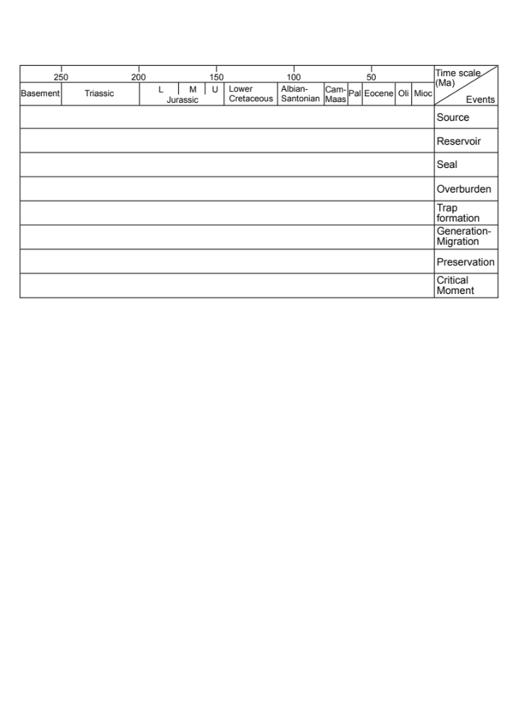

Slide 6
No Seal!
Seal
Seal
Reservoir
Seal
Seal
Reservoir
Reservoir
Seal
Reservoir
Reservoir
Reservoir
Seal
Reservoir
Reservoir
Seal
Reservoir
Reservoir
Source
Seal

Slide 7
